Slide 1


Minor Project
Title: Tour and Travel Management Portal
Presented by:
R200220001 - Aakash Bhatt
R200220066 - Anurag
R200220070 - Aman Ali Ansari
Mentored By:
Dr. Ajay Prasad.
Designation – Professor.
Informatics Cluster.

Slide 2
Content
Introduction
Literature Review
Objectives
Methodology
Working Model
References

Slide 3
Introduction
The primary reason of the excursion and travels control device is to offer a first-class facility and journeying services for a client to book excursion programs, resorts, and vehicle or bus tickets for trip functions. this is alternatively to provide the great journeying offerings to the clients and tour marketers. we've got multiplied excursions and journey administration approach to offer an exploration platform in which a traveler can discover their ride spots in step with their selections. This technique further assists to sell reliable and captivating tourism in order that human beings can have a good time their holidays of their favored locations. This process also encourages increasing tourism with exclusive cultures, groups, in order that they decorate the tourism revel in, journey, and construct satisfaction.
We are developing this machine to set up and extend the shape of tourism that gives healthful interplay possibilities for tourists and natives and improves a better attention of different cultures, traditional life, traditional know-how and moralities. This undertaking is useful for vacationers who are unexpected with the locations wherein they want to visit. The utility presentations geographic-based data to the humans moving to the exclusive towns and to the folks that are ready to head on a journey. The consumer can choose any of the 3 selections to be had, which incorporates tour, meals and accommodation centers it is a completely efficient and dependable undertaking.

Slide 4
Literature Review
Travelers' viewpoints on information search, as well as market segmentation by information/booking channel. Investigating the causes of travelling using various information sources also raises the question of what is the observable result of that behavior. Nevertheless, there are a lot of things that we discover and really understand about the locations. It is beneficial to have a thorough understanding of historical objects and cultures. The major subjects for learning about and debating it include grand tours, travel, and tourism.
Information on tours and travels can be found mostly through communication channels like newspapers and magazines. As mobile technology advances, information is now available within the device itself. Today, mobile technology is expected to enhance tourism in a number of ways. People desire quick and simple solutions because of their hectic schedules. The internet-based tour management system offers guests self-guidance through their mobile devices.

Slide 5
Objective
Create a graphical user interface.
Create a sign-up form on the portal.
Connecting the portal with the MySQL Database.
Store and fetch the data from the Database.
Create the dashboard of the portal.

Slide 6
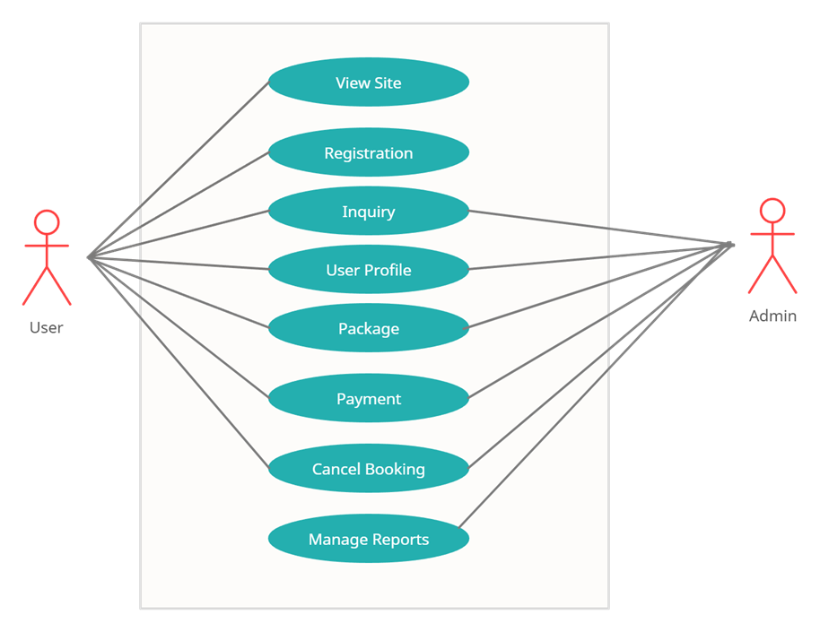
Methodology
The working of the Tour and Travel Management Portal can be configured by using the UML diagrams effectively.
Use case diagram.
Activity diagram.
Class diagram.
Use Case Diagram

Slide 7
Methodology
Class Diagram

Slide 8
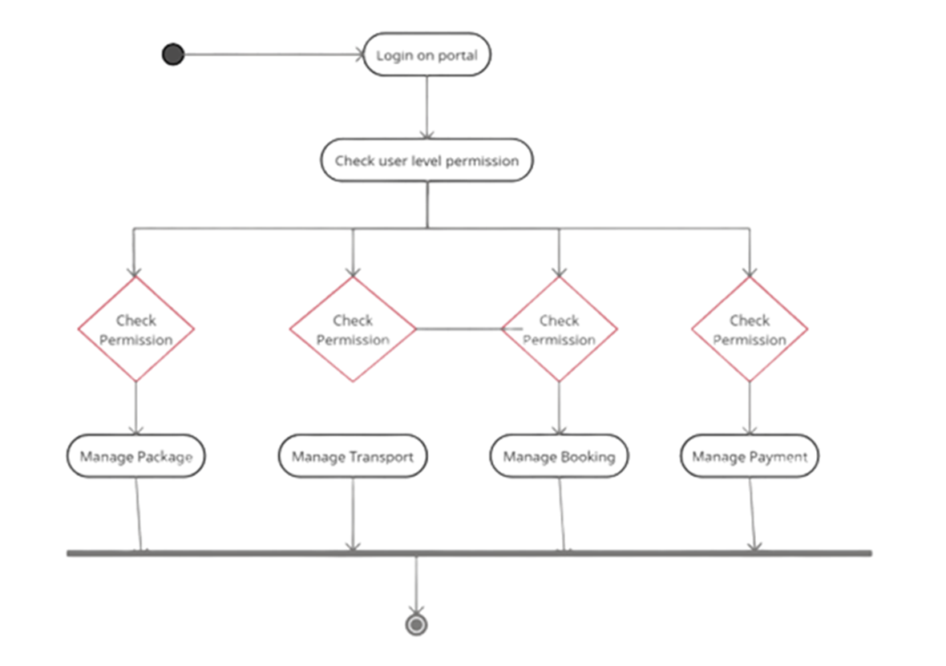
Working Model
Link of SRS: https://1drv.ms/w/s!AtHrDoz14Dpji3IFxtaVYzTbxXt0
Technical Diagram:

Slide 9
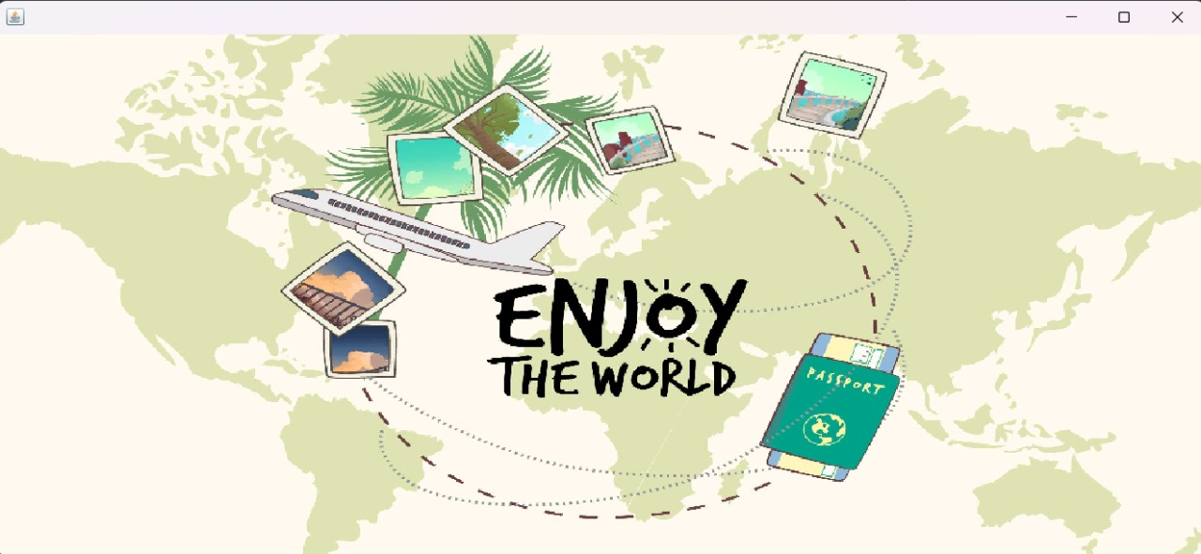
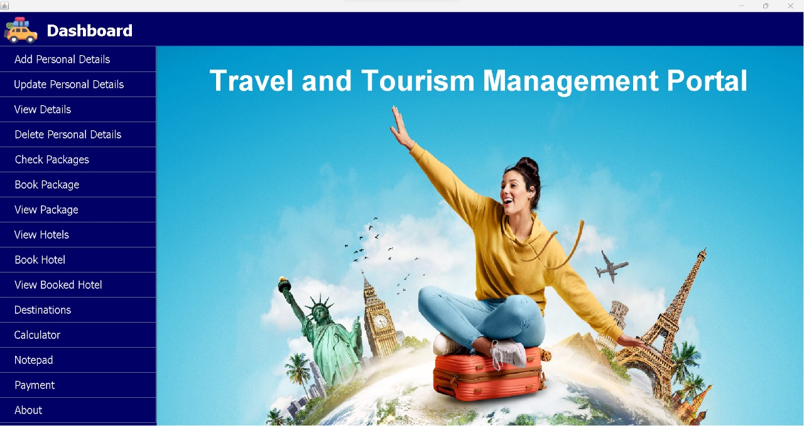
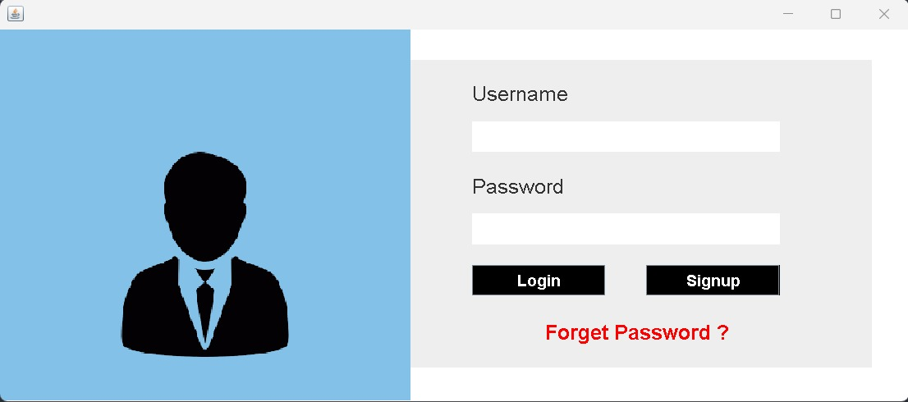
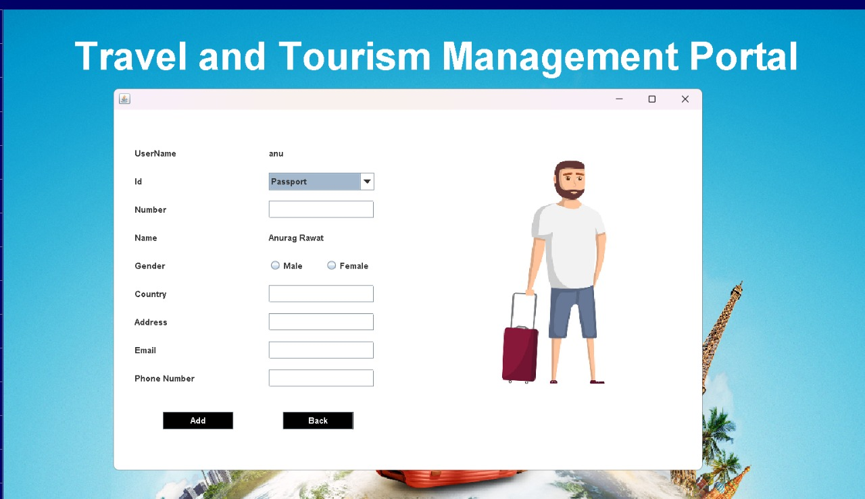
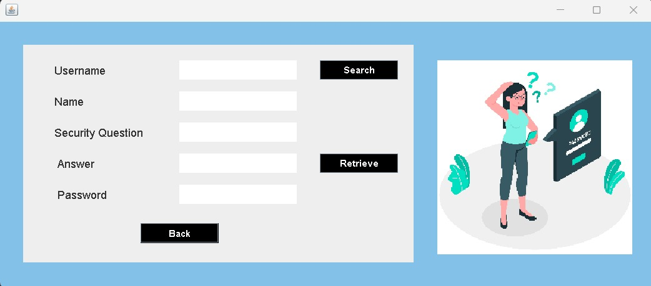

Slide 10
Reference
Book - JAVA The Complete Reference – 11th edition.
External website – https://www.javatpoint.com/java-awt
External website - https://www.javatpoint.com/java-swing

Slide 11
Thank You

